Slide 1


HOW TO BE AN EFFECTIVE OPEN-SOURCE PROJECT PARTICIPANT
David Poindexter

Slide 2






Who Am I
David Poindexter
CEO, nvisionative, Inc. (www.nvisionative.com)
DNN Leadership Team, Strategy
Board of Directors, DNN Connect
Co-President, Southern Fried DNN
Creator, nvQuickSite
Co-Creator, nvQuickTheme
Creator, nvQuickComponents
Creator, nvQuickPulse
Creator, nvQuickPersonaBar
@nvisionative
@david-poindexter
@nvisionative
@dpinnovation
@nvisionative
@davidpoindexter
@nvisionative
@dpoinde

Slide 3
What We Will Cover
What Is Open-Source
Why Should I Care?
I Don’t Git It!
GitHub: Non-Traditional Uses
GitHub: Why Devs Love It
GitHub: Terminology
GitHub: Hands-On
Contributions For Devs
Contributions For Non-Devs

Slide 4
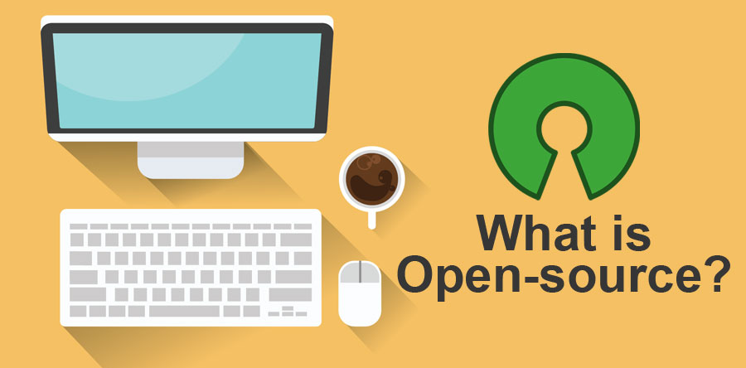

Slide 5

OPEN-SOURCE

Slide 6

OPEN-SOURCE

Slide 7


Slide 8


Slide 9
I Don’t Get It!
What is git?

Slide 10
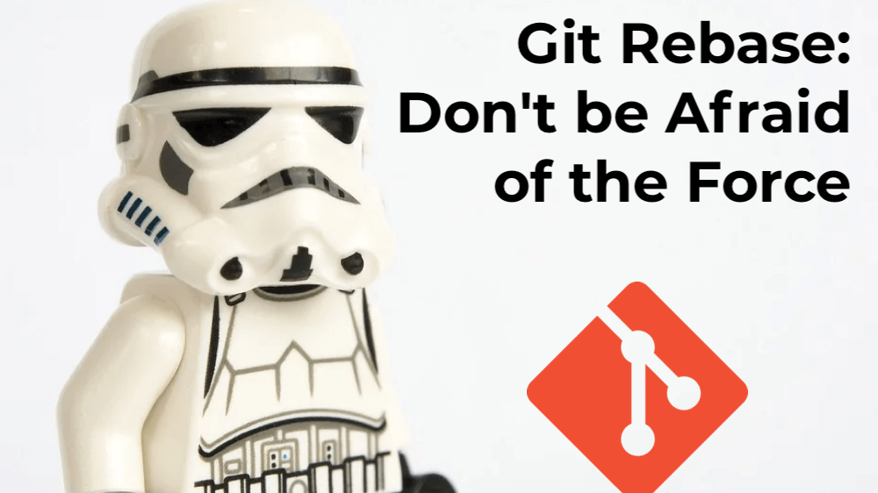

Slide 11
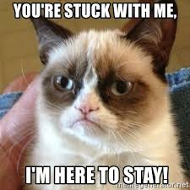


Slide 12
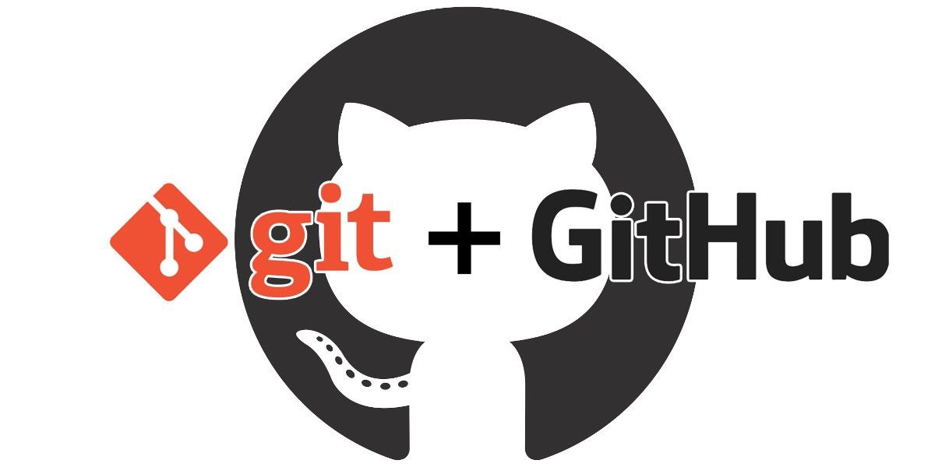

Slide 13
Outside The Box Usage
github
Notes:
Authors
Presentations
Designs
Processes
Workflows
Documentation

Slide 14
Why Developers Love It So Much
github
Notes:
Based on Git (which is open-source too)
Share Projects
Store Code
Retain History
Collaborate With Others
Show Off Their Mad Skills

Slide 15
Terminology
github

Slide 16

Repository (Repo)

Slide 17
Code Commits - Branches - Releases -

Slide 18
Issues

Slide 19
Pull Requests

Slide 20
Projects

Slide 21
DOING SOMETHING WITH IT
github
Notes:
Interaction (Hands-On Demo)
Fork
Clone
Pull
Branch
Push

Slide 22
Non-Code Ways To Contribute
Open-source

Slide 23

advocate
open source

Slide 24
educate
open source

Slide 25
promote
open source

Slide 26
recruit
open source

Slide 27
knowledge base
open source
Notes:
Documentation
Training
Videos
Q&A

Slide 28
design
open source

Slide 29
ux
open source

Slide 30
translate
open source

Slide 31
issues
open source

Slide 32
processes
open source

Slide 33
meetups
open source

Slide 34



Notes:
PRESENTER: David Poindexter

Slide 35
Q&A
What would you like to know?
Notes:
PRESENTER: David Poindexter & Daniel Valadas

